Slide 1
GESTURE CONTROLLED ROBO
Presented by
ADITYA VERMA
ECE-IOT, 3rd year
SVVV University, Indore

Slide 2
ABOUT
The objective of this project is to build a robo that can be controlled by gesture wirelessly
User will be able to control motions of the robo by wearing the controller glove(transmitter) and performing predefined gestures.
Can be used in many potential applications such as wireless control car racing, gesture controlled wheelchair, in toys, etc.

Slide 3
MAIN COMPONENTS
2 Arduino nano (microcontroller)
2 NRF24l01 (transceiver)
MPU6050 sensor (Gyro + Accelerometer)
L298n (motor driver)

Slide 4
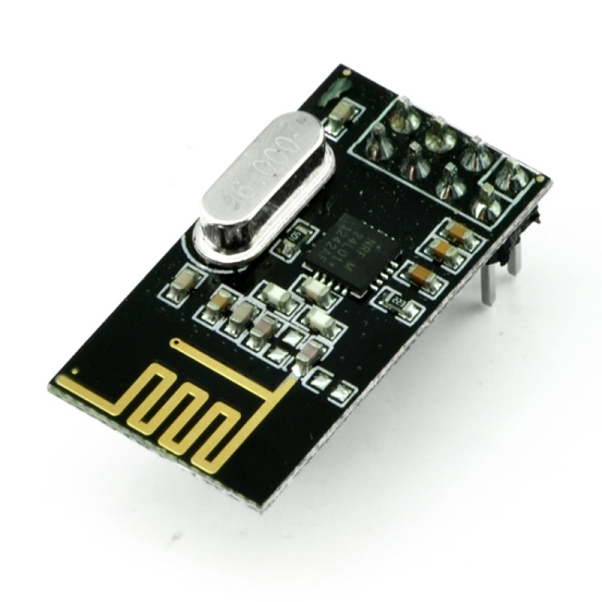
NRF24l01 transceiver module
nRF24L01 is a single chip radio transceiver for the world wide 2.4 - 2.5 GHz ISM band.
On the air data rate 1 or 2Mbps.
Digital interface (SPI) speed 0-8 Mbps.
125 RF channel operation.

Slide 5
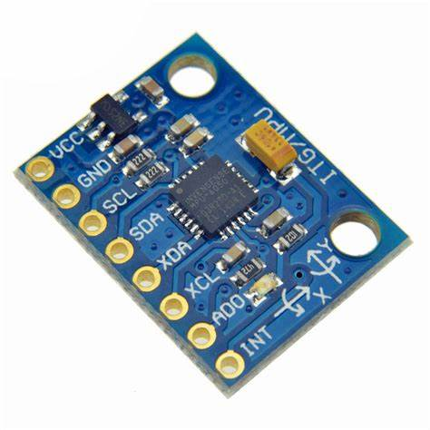
MPU6050
The MPU6050 is a Micro Electro-Mechanical Systems (MEMS) which consists of a 3-axis Accelerometer and 3-axis Gyroscope inside it.
It is very accurate, as it contains 16-bits Analog to Digital conversion hardware for each channel.
Therefore it captures the x, y, and z channel at the same time.

Slide 6
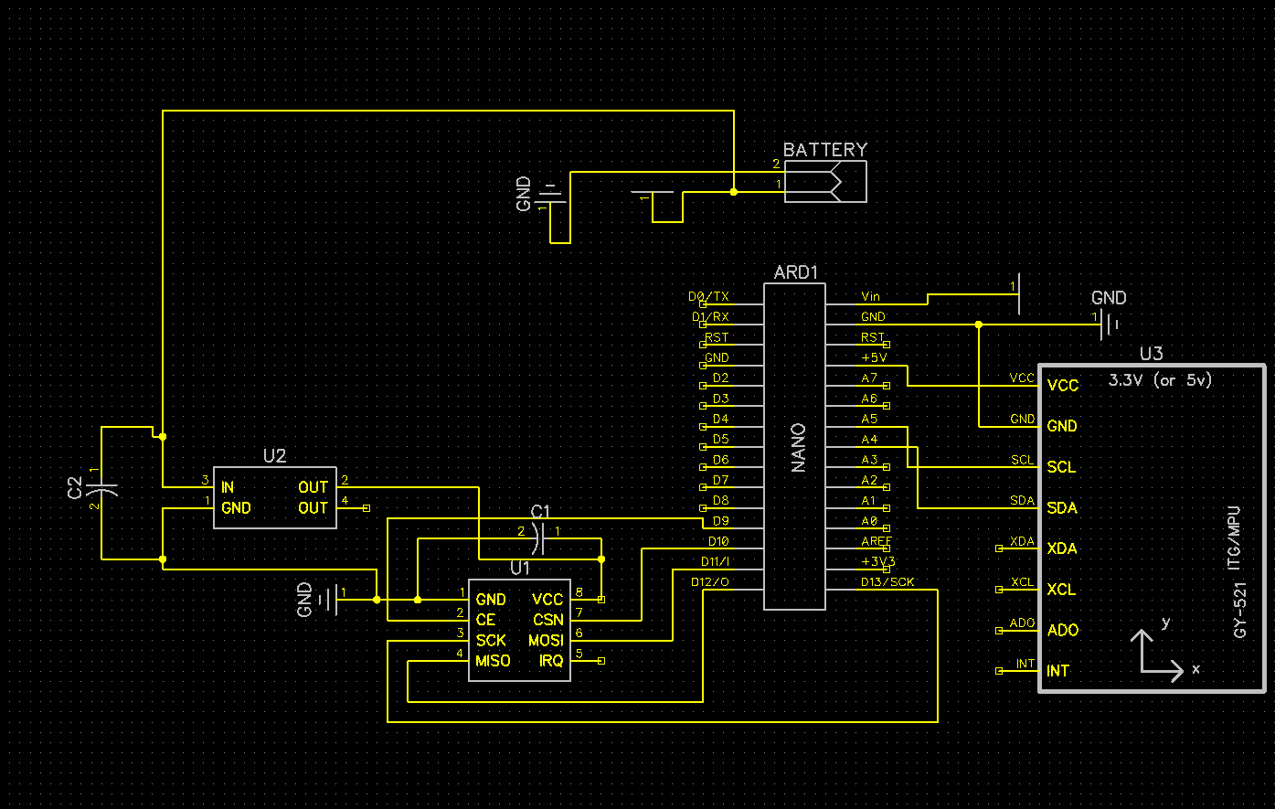
CIRCUIT DIAGRAM TRANSMITTER

Slide 7
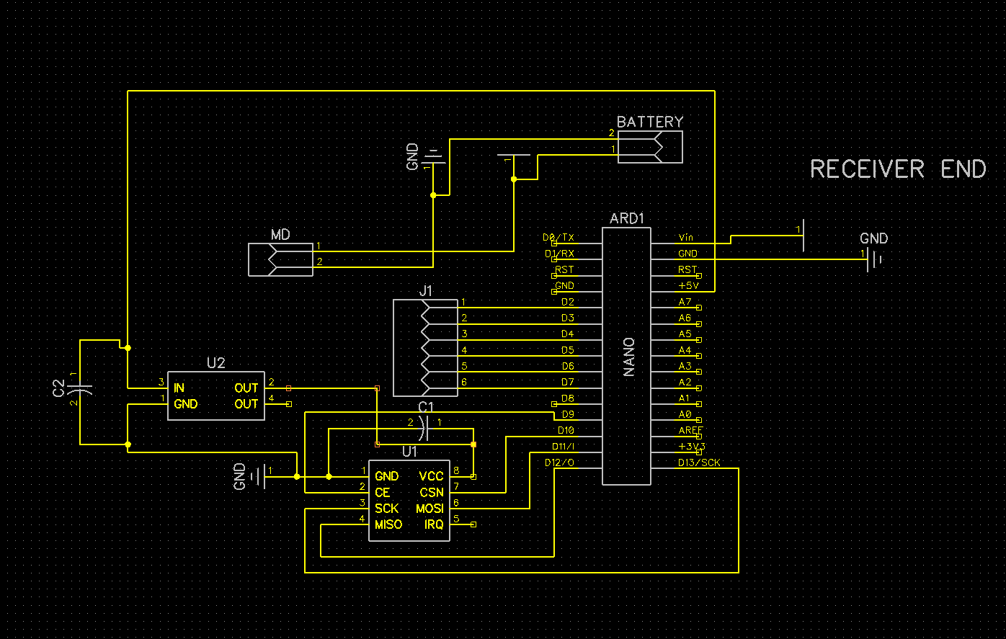
CIRCUIT DIAGRAM RECEIVER

Slide 8
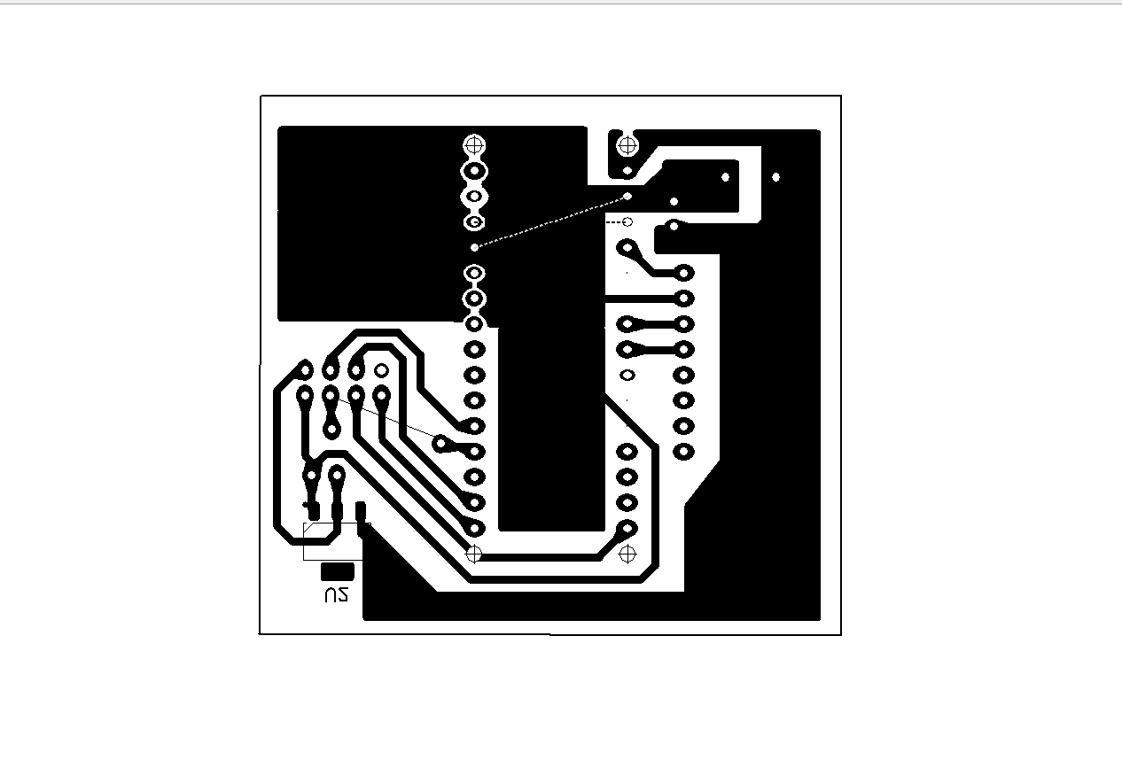
PCB BOTTOM VIEW TRANSMITTER

Slide 9
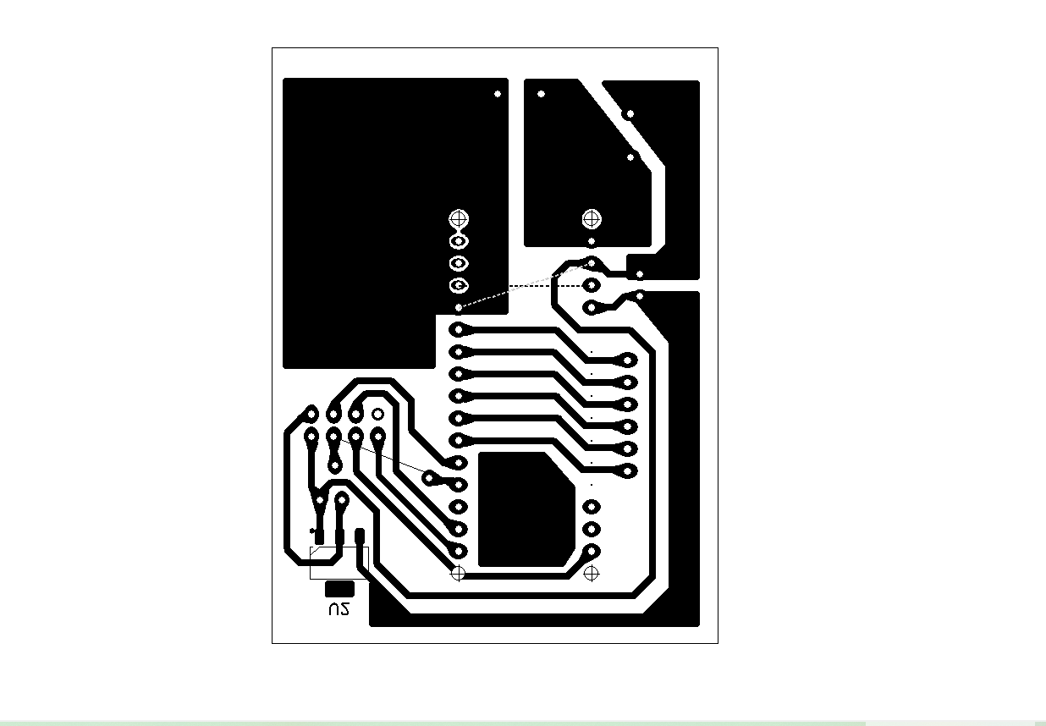
PCB BOTTOM VIEW RECEIVER

Slide 10
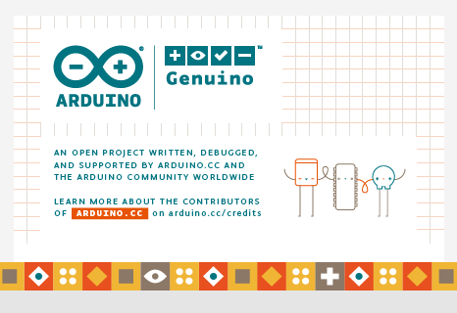
SOFTWARE USED
ARDUINO IDE

Slide 11
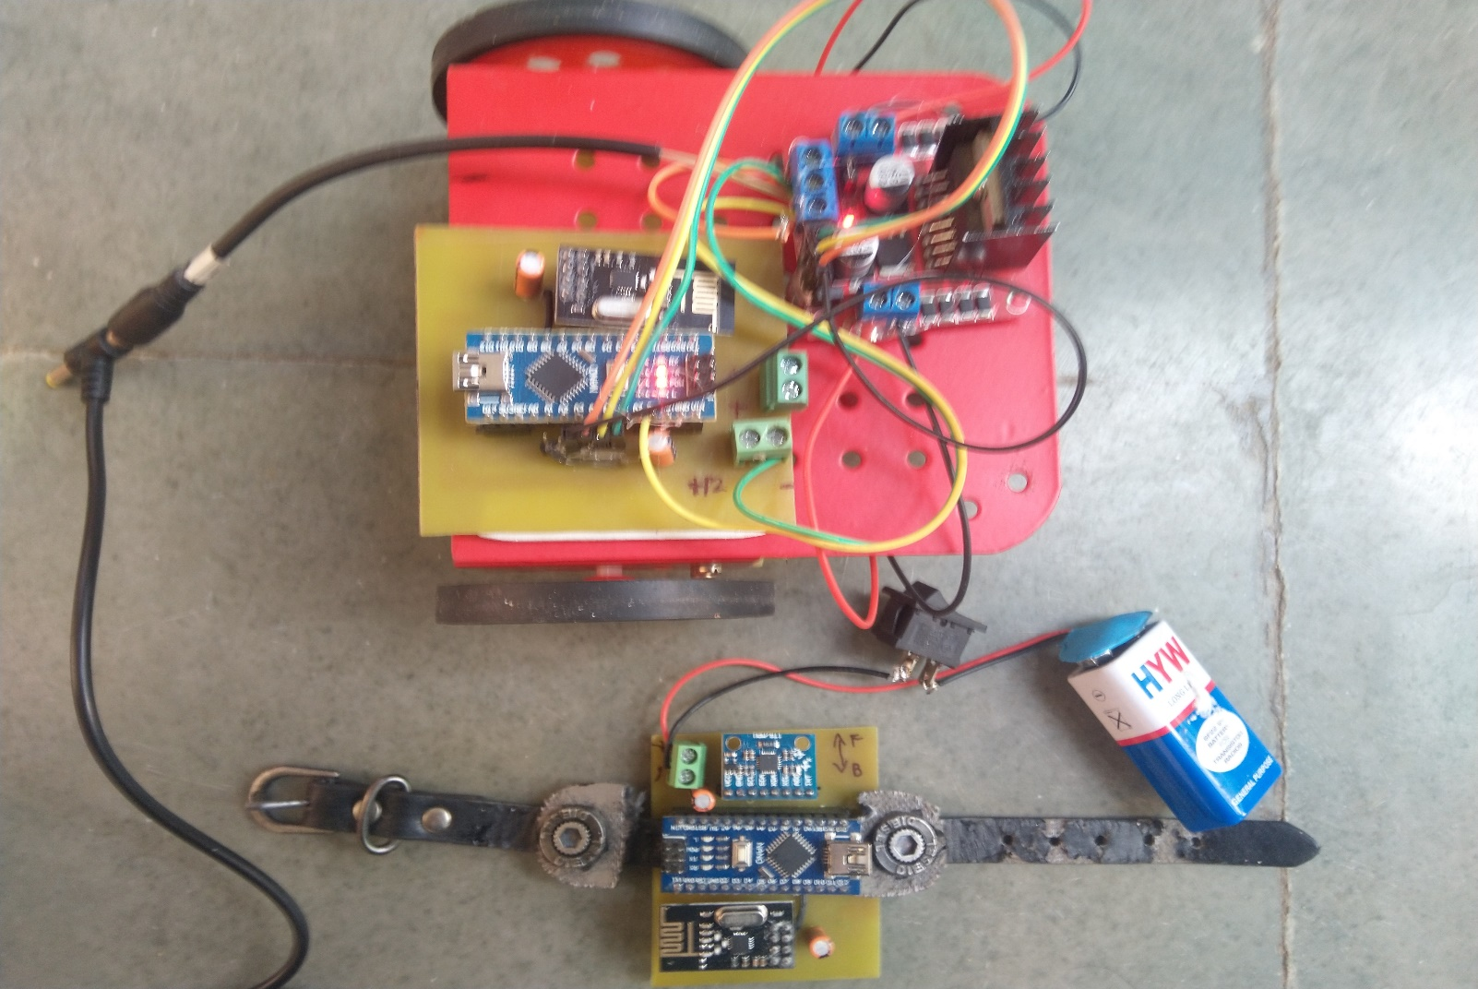
THANK YOU

